Slide 1
AirInterface
objectIdReference
LTP

Slide 2
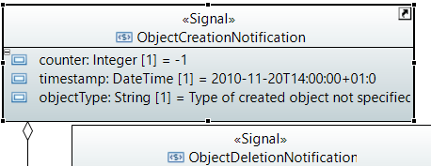
MicroWaveNetworkInventory (MWNI)
Notification for new ControlConstruct
Anstatt von /v1/notify-availability-of-new-device
SDN-Control-Domain
ControlConstruct
_objIdRef = CC-uuid + mount-name
(without mount-name not unique)
/v1/notify-object-creations
/v1/regard-object-creation
(answer to)
*
CC
*
Links
*
LTP
*

Slide 3
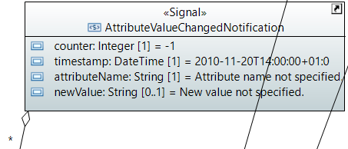
MNDI
Anstatt von /v1/notify-changed-attribute-value
SDN-Control-Domain
/layer-protocol=2146697857/air-interface-2-0:air-interface-pac/air-interface-configuration/performance-monitoring-is-on
_objIdRef = <uuid> = mount-name + ltp-uuid
/v1/notify-attribute-value-changes
*
=> /v1/regard-attribute-value-change
CC
*
Links
*
LTP
*

Slide 4
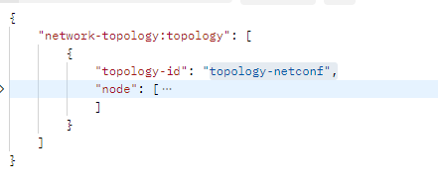
http://<ctrlIP>:8181/rests/data/network-topology:network-topology/topology=topology-netconf
MWDI path „/“
MWNI will provide two elements on topology-netconf level:
node list (also in Controller)
link list (NOT in Controller, just in App)
Link list: each link contains shared-associations between LTPs under the ControlConstructs
SDN-Control-Domain
*
CC
*
Links
*
LTP
*

Slide 5
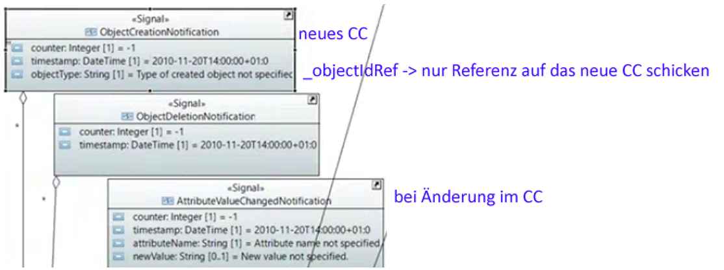
Notification content
TR532
objectIdReference is included in all, but not shown explicitly

Slide 6
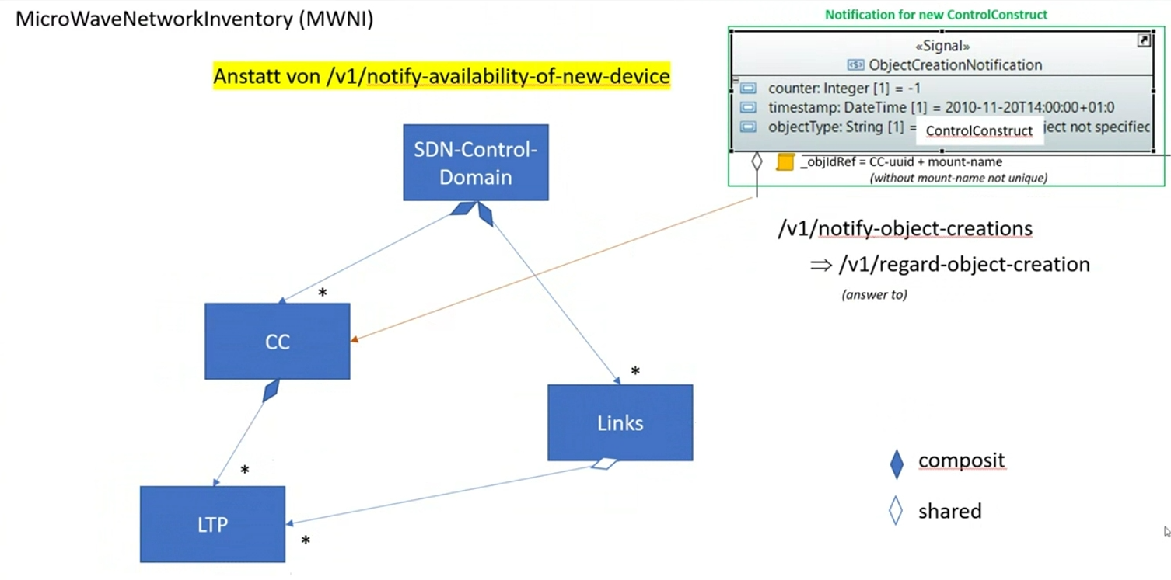
Shared vs. composite association

